Slide 1
Label-based Access Control
Mike Kulakov, Aidbox FHIR platform

Slide 3
How do we handle access to confidential and sensitive data in Aidbox?

Slide 4
FHIR Security Labels?

Slide 5
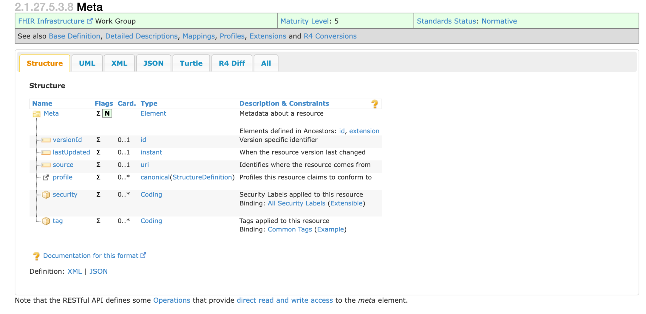
A security label is a concept attached to a resource or bundle that provides specific security metadata about the information it is fixed to

Slide 6
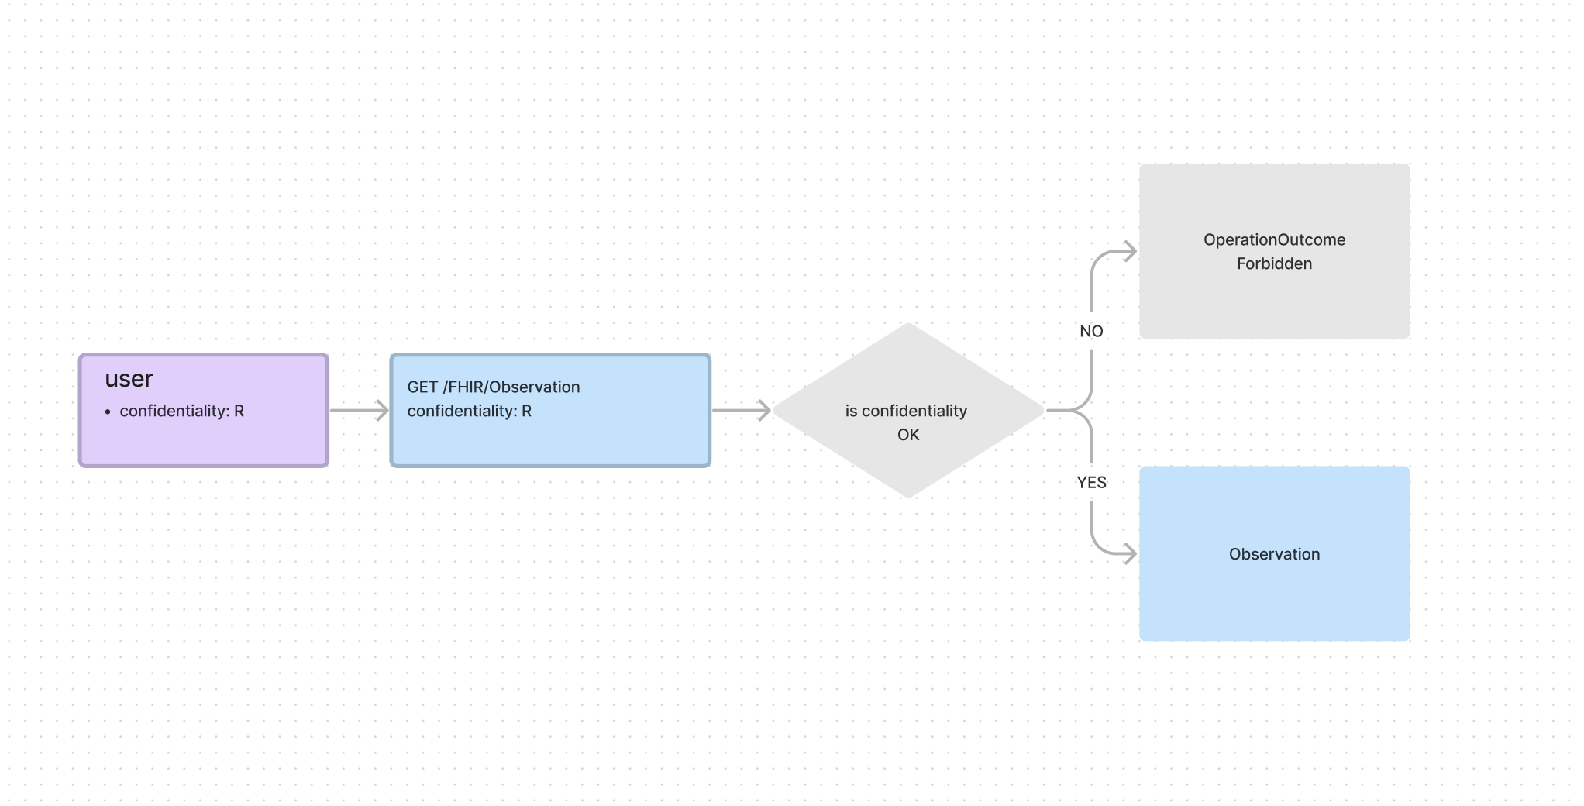
Access Control on Security Labels

Slide 7
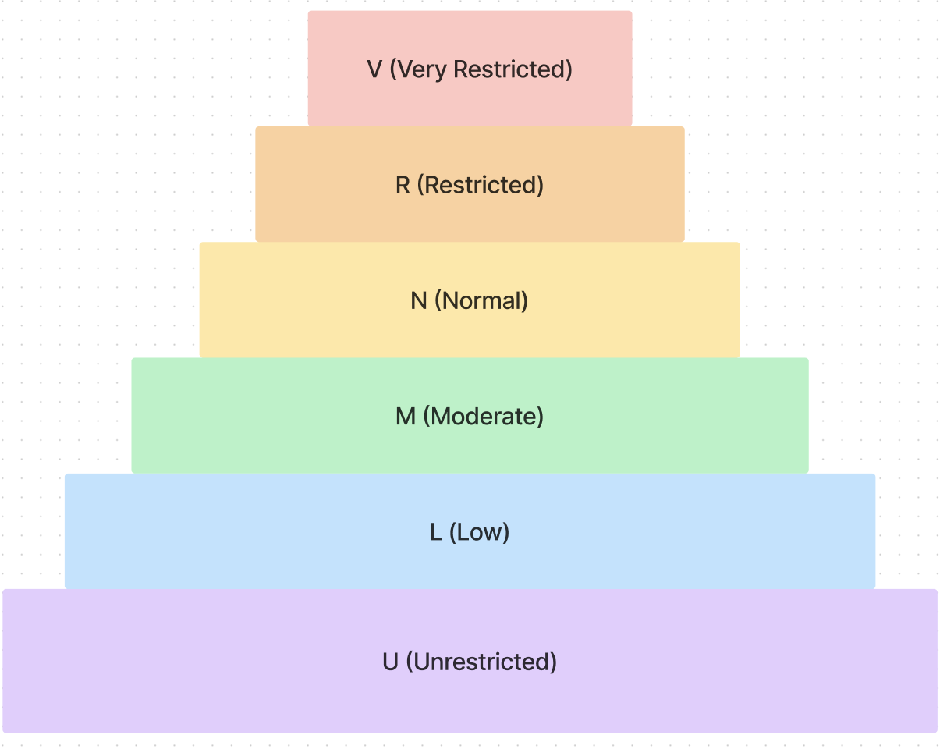
Confidentiality codes https://terminology.hl7.org/ValueSet-v3-Confidentiality.html
The Confidentiality classifications describe the sensitivity of the information.
U (unrestricted)
L (low):
M (moderate)
N (Normal)
R (Restricted)
V (Very Restricted)

Slide 8
Can we be more granular and non-hierarchical?

Slide 10
What about elements of a resource?

Slide 11
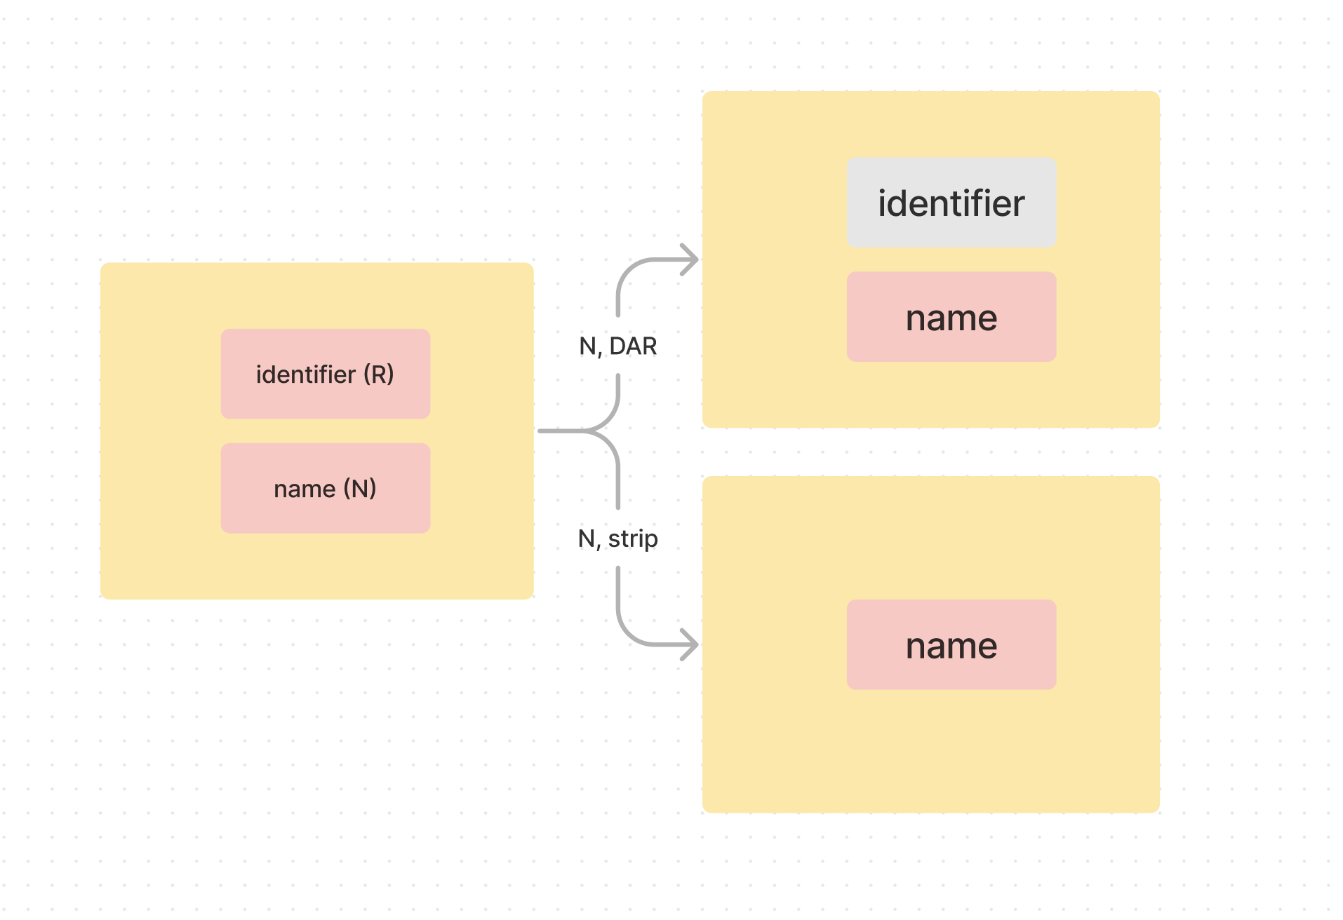
Что я ищу и что нахожу

Slide 12
Inline security labels
Add PROCESSINLINELABEL to resource meta
Security label on resource element via an extension

Slide 13
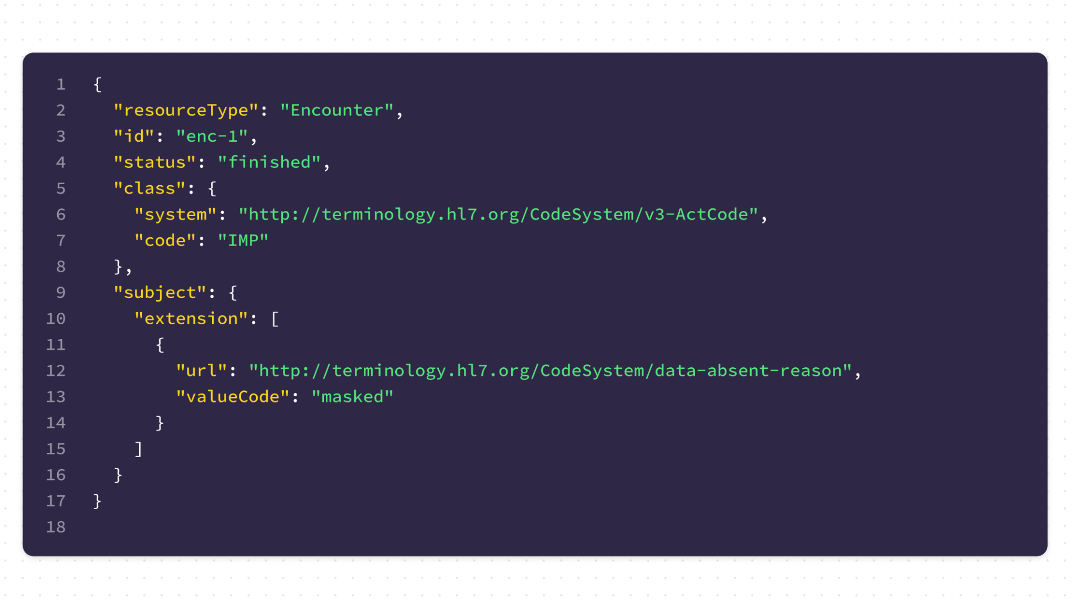
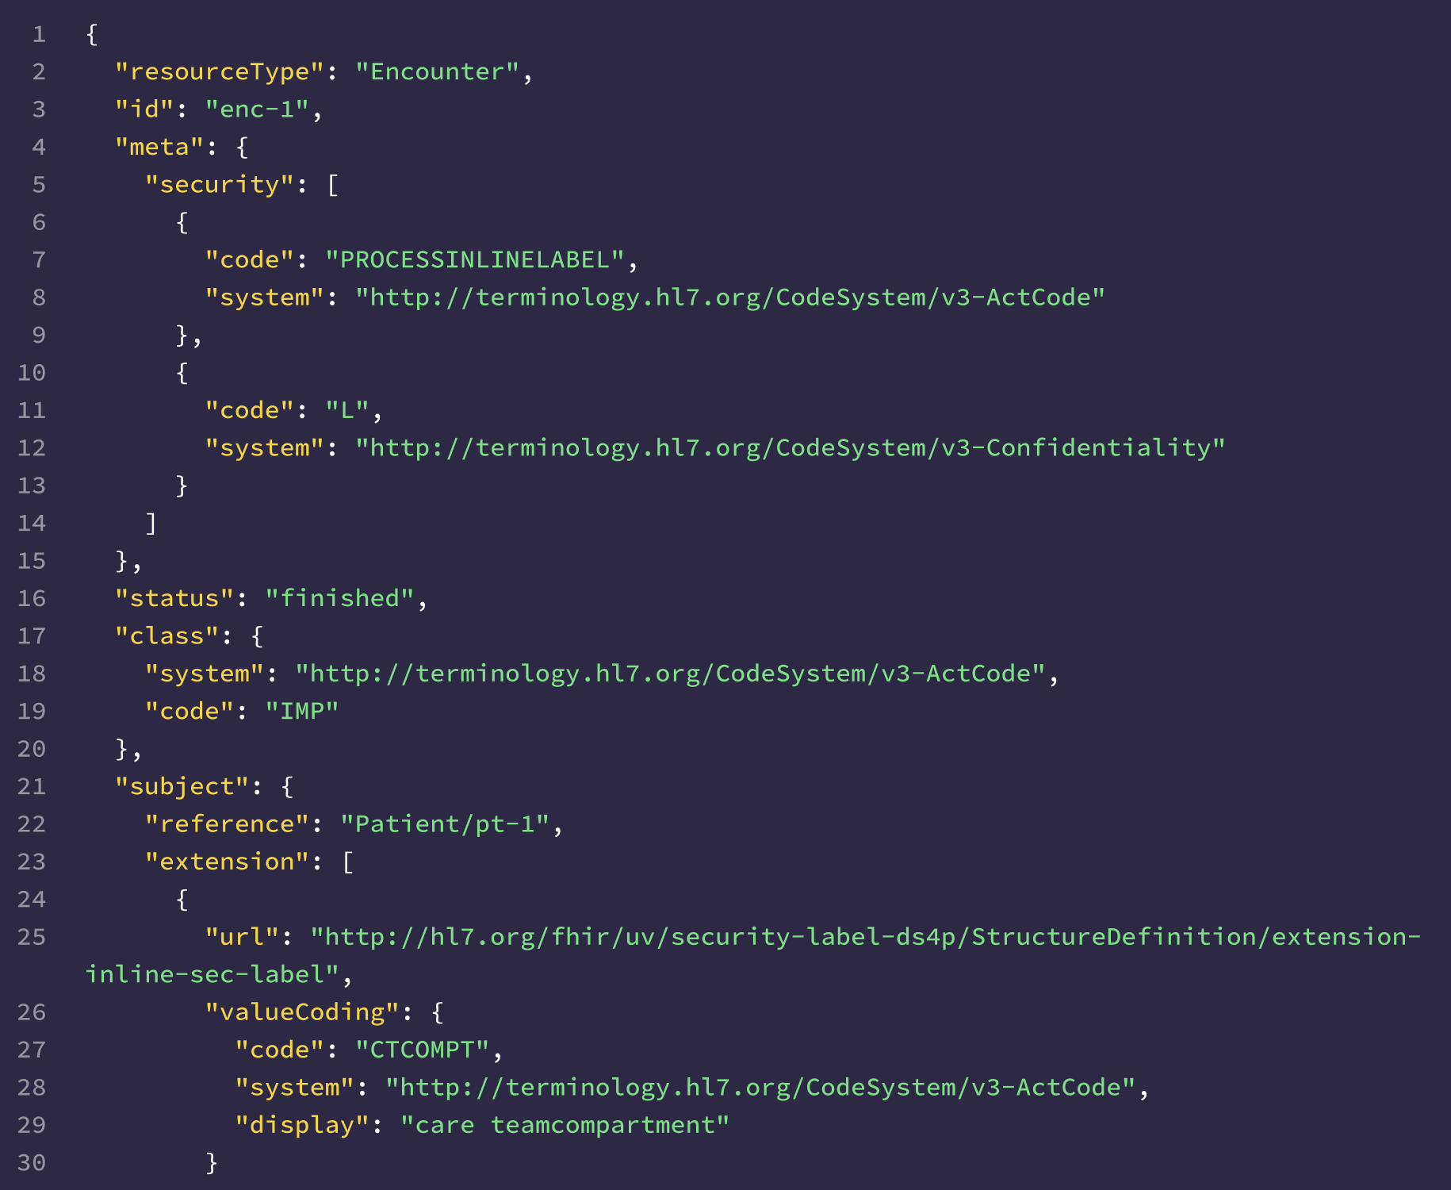
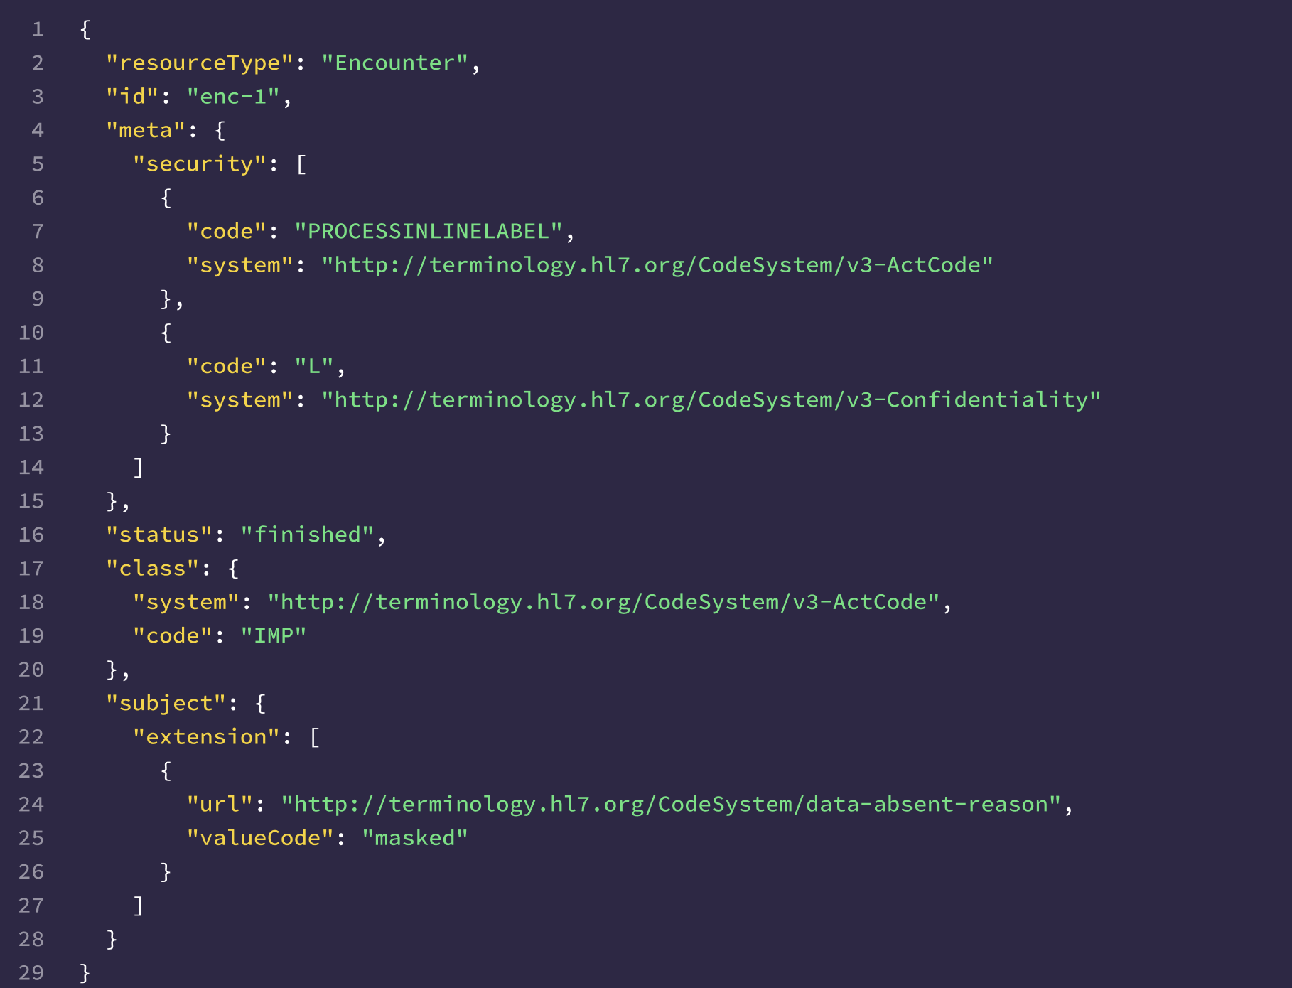

Slide 14
Medical Safety vs Data Leakage
Use-case dependent
Organizations must weigh the risk of compromising medical safety against the benefits of enhanced privacy.
The disclosure of data absence can sometimes be a data leak
Сomplications of not revealing data access denials which might be interpreted as data not existing.
Nice discussion on FHIR Chat here

Slide 15
Privacy vs Conformance
What happens if we mask a required element in FHIR resource? It will be non-conformant.

Slide 16
Aidbox: current state
Security_labels_enabled: If a resource has no security label it is not available via API
Explicit security labels from external Security Labeling Service (SLS)
Strip security labels mode

Slide 17
Aidbox: next steps
Rules for labelling and access control
SLS to apply labels
More DS4P cases. Talk to us about your challenges!

Slide 18
Thank you!
Aidbox: https://www.health-samurai.io/aidbox

